Slide 1


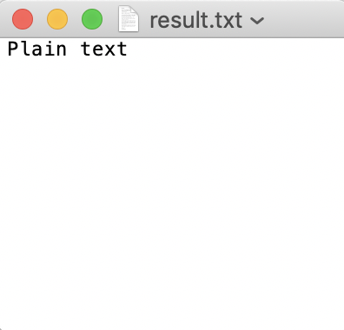
Voice record device
Audio files
Plain text

Slide 2
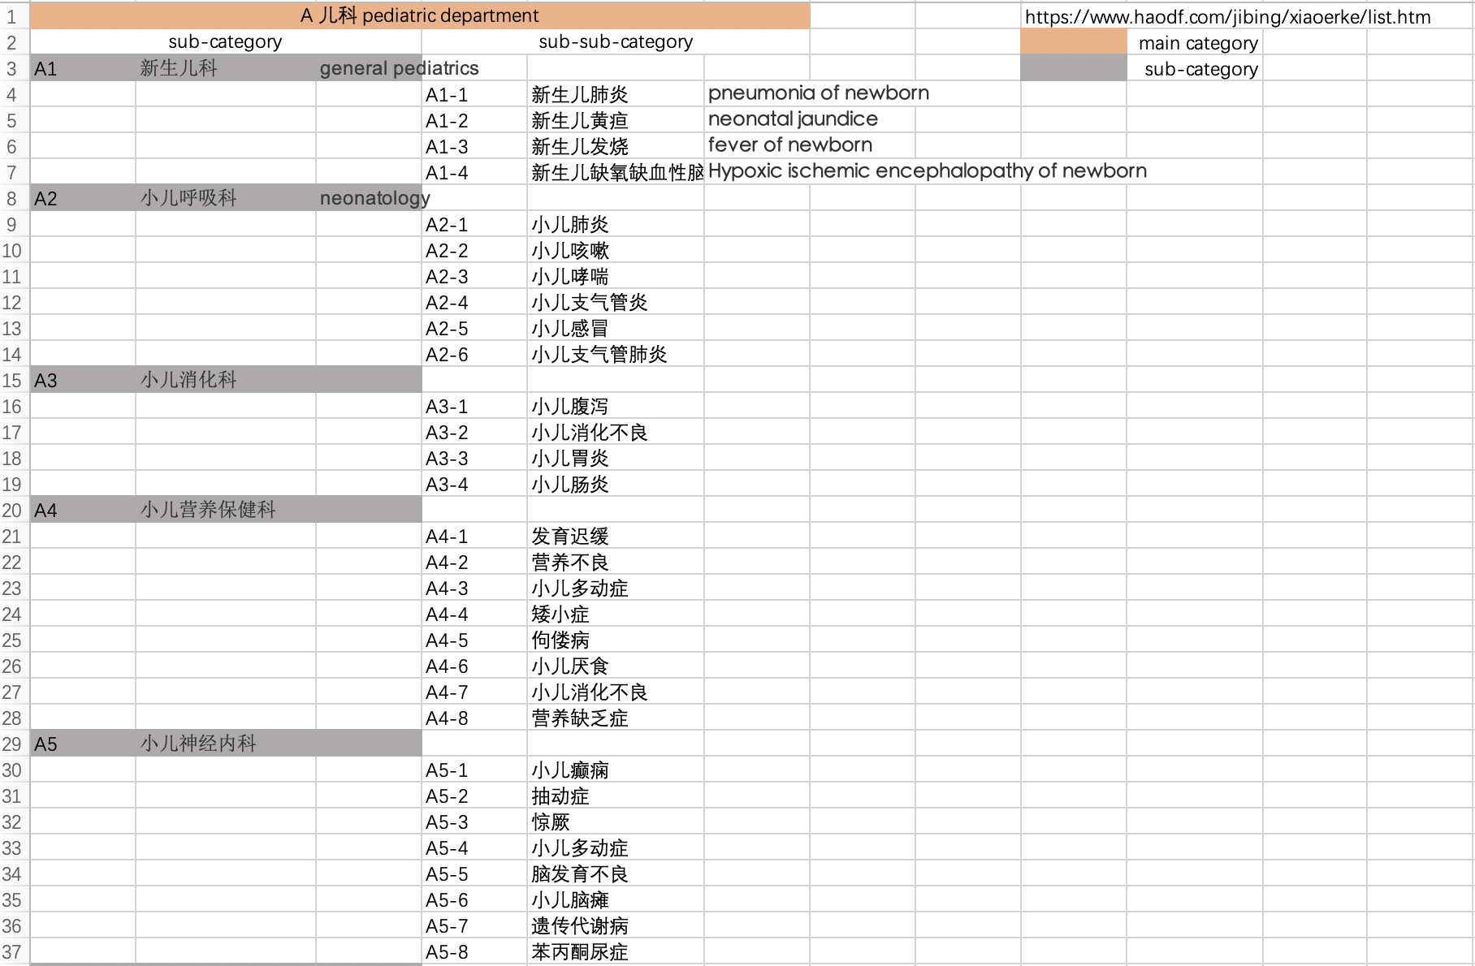
main category
Sub-sub-category (disease)
Sub-category
ww
labels

Slide 3
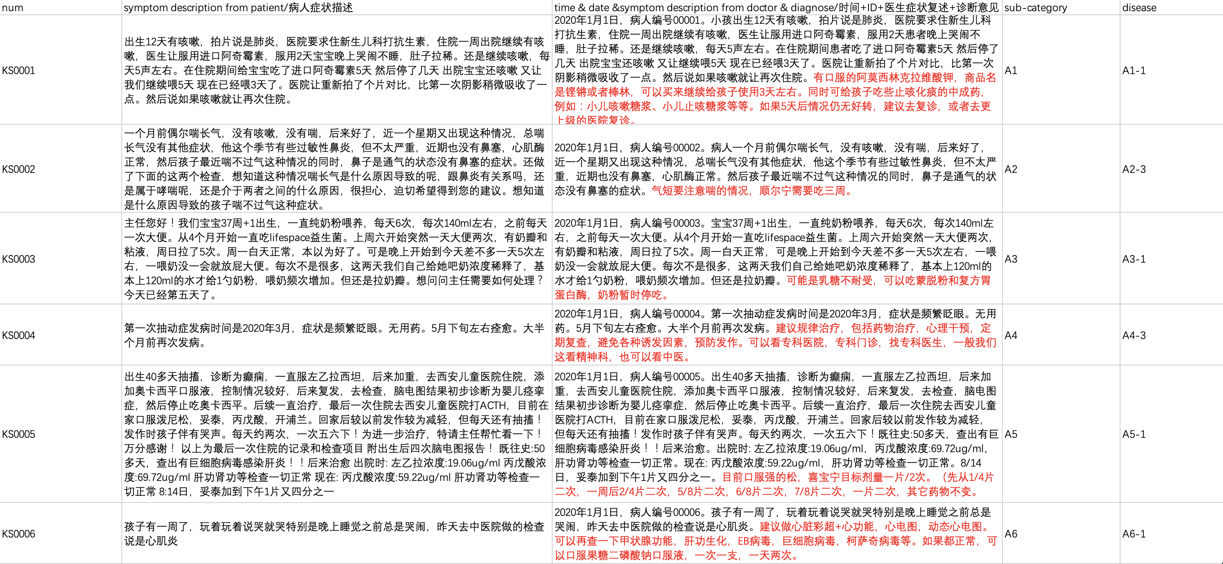
No.
Symptom description
Doctor’s diagnose
labels

Slide 4
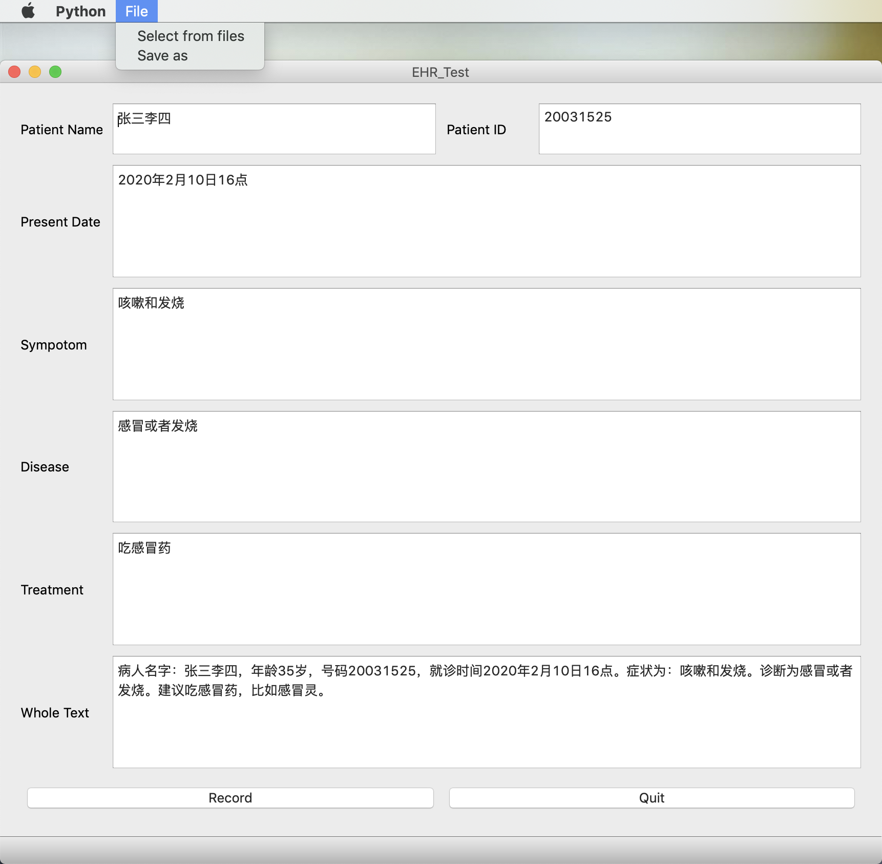
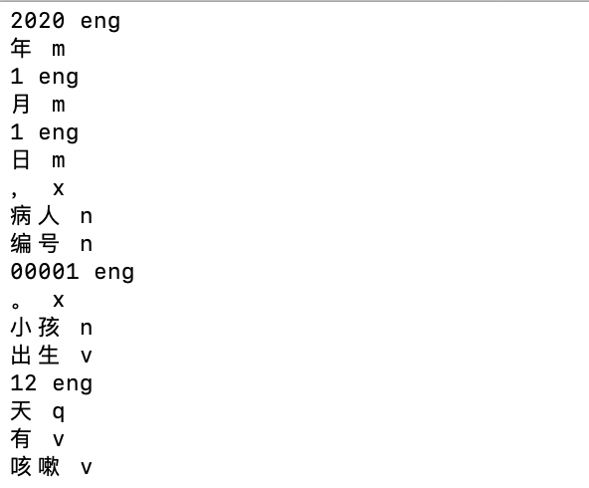
Voice recognition
Voice record device
Audio files
Plain text
Cutting & Tagging
Trigger words detection
EHR form filled by pre-defined trigger words
Tagged words

Slide 5
Input: speech on symptom and diagnose
Data collection
Convert audio into text
Information extraction
Data processing
Use extracted info to do disease prediction
Output: disease prediction
Outcome

